Slide 1
Predictive model for Energy Consumption and Electricity Generation
Pranita Dhole

Slide 2
Problem Statement
The primary goal is to gain insights into global energy consumption patterns, identify trends in renewable and non-renewable energy sources, and classify countries based on their energy self-sufficiency levels. This analysis aims to provide a comprehensive understanding of the energy sector and its impact on greenhouse gas emissions, as well as identify countries that are heavily reliant on energy imports and potential areas for increasing domestic energy production or diversification. Develop a predictive model to forecast global energy consumption based on historical data.

Slide 3
Data Exploration
Data Source:
Utilizing World Energy Data from “Our World in Data”.
Overview:
Includes key metrics like primary energy, per capita consumption, growth rates, energy mix, and electricity mix.
International Energy Agency (IEA):
Established in 1974, provides global energy data and policy recommendations.
Data Scope:
Focus on data from 1974 onwards, excluding non-country entities from the dataset.
Original shape:
(22,012 rows, 129 columns)After preprocessing: (16,113 rows, 129 columns)

Slide 4
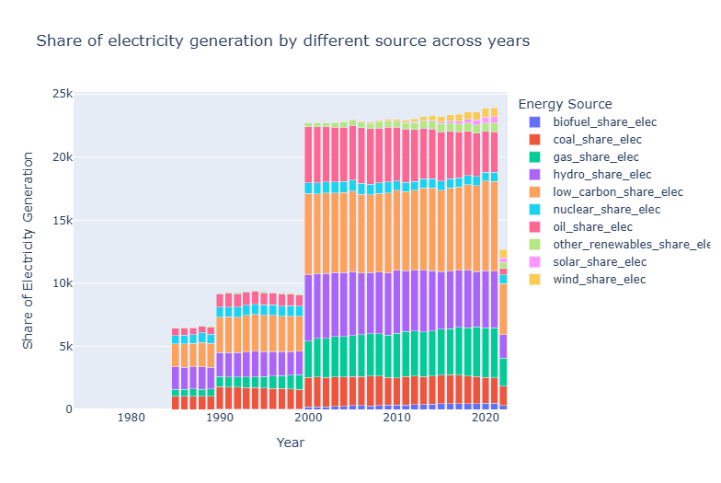
Exploratory Data Analysis (EDA)
Insights from EDA
Displays the share of electricity generation
by different sources over the years.
Overall Trend:
Clear upward trend in electricity generation
capacities over the years.
Key Factors:
Adoption of technology from more
developed countries.
Increased focus on renewable energy sources,
leading to sudden spikes in capacity.

Slide 5
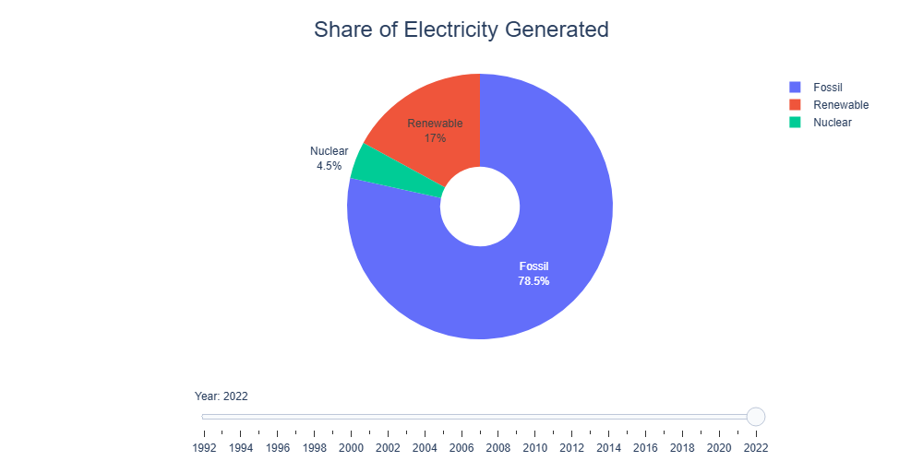
EDA
Insights from EDA
Increasing focus on generating energy from renewable sources over the years.
Renewable Energy Contribution:
In 1992: Approximately 9%.
By 2022: Increased to around 17%.
Other Sources (2022):
Nuclear: Contribution around 4%.
Fossil Fuels: Contribution around 78%.

Slide 6
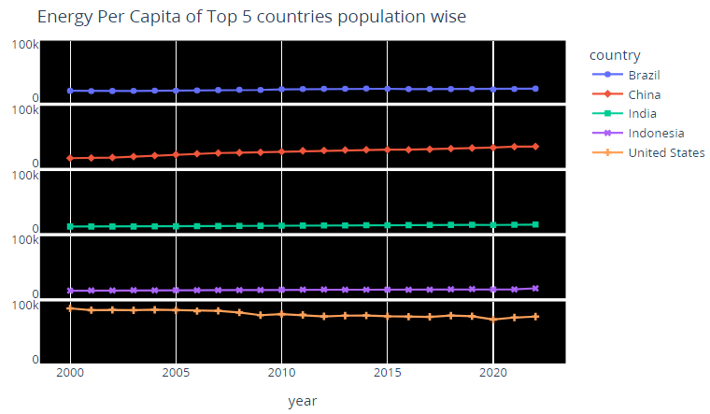
EDA
It can be concluded that countries with larger populations tend to have lower energy_per_capita

Slide 7
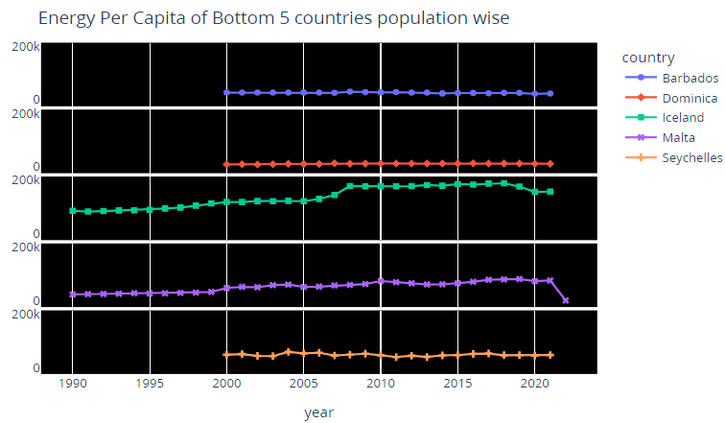
EDA
It can be concluded that countries with with smaller populations exhibit higher energy_per_capita.

Slide 8
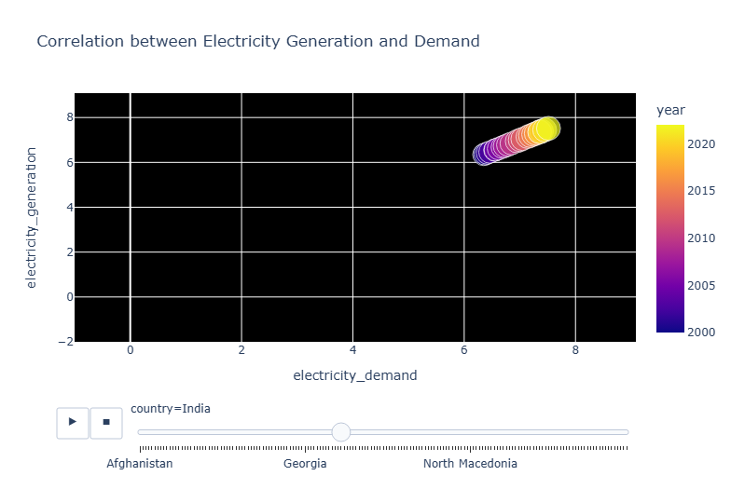
EDA
Electricity Demand and Supply: Steadily increasing over the years.
Developed Nations (USA, Canada, UK, France): No significant surge in demand or generation capacity. Values have remained relatively stable.
Smaller European Countries (Norway, Netherlands, North Macedonia, Serbia, Luxembourg): imilar stable pattern as in developed nations.
Emerging Economies (India, China, Argentina, Israel): Sharp upward trend in demand and generation capacity.

Slide 9
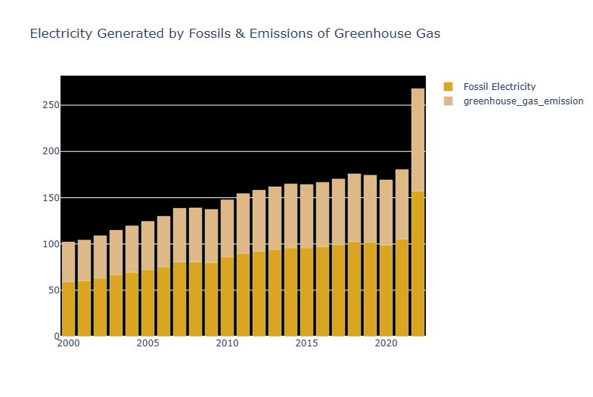
EDA
Greenhouse Gas Emissions:
Despite regulations, emissions have grown over recent decades.
Need for Change:
Indicates a need to shift focus towards renewable energy sources for generation.

Slide 10
Data Preprocessing
Feature Engineering:
Selected relevant columns for model building.
Created a new feature: 'energy_production_ratio'.
Data Scaling:
Applied MinMaxScaler to numerical features.
StandardScaler to the 'year' column.
Handling Categorical Variables:
Used LabelEncoder for 'country' and OneHotEncoder for target labels.
Target Label: Categorical labels for energy self-sufficiency levels ("High," "Moderate," "Low").
Classification of countries by energy security and self-sufficiency.

Slide 11
Model Building
Classification Task:
Classify countries based on energy self-sufficiency.
Algorithms Used:
Logistic Regression.
Decision Tree Classifier.
Hyperparameter Tuning:
Optimized parameters for better performance.
Used GridSearchCV for logistic regression.
Feature Selection:
Applied RFE and RFECV for feature selection.

Slide 12
Model Evaluation
Metrics:
Accuracy, Precision, Recall, F1-score.
Results:
Logistic Regression outperformed Decision Tree Classifier.
Best model achieved [specific accuracy score] after hyperparameter tuning and feature selection.

Slide 13
Business Insights
Trends in Energy Generation:
Shift towards renewable energy sources observed.
Developed nations show stable demand and generation patterns.
Emerging economies exhibit sharp upward trends in energy demand and generation.
Energy Security:
Identified countries heavily reliant on energy imports.
Highlighted potential areas for increasing domestic energy production or diversification.

Slide 14
Recommendations
Policy Recommendations:
Increase investment in renewable energy sources to reduce reliance on fossil fuels.
Implement policies to promote energy efficiency and conservation.
Develop strategic partnerships for energy trade to ensure energy security.
Technical Recommendations:
Further refine the model with more granular data and additional features.
Explore advanced machine learning techniques for better predictive accuracy.

Slide 15
Conclusion
Summary of Findings:
Successfully developed a predictive model to analyze global energy consumption and generation.
Identified key trends and insights for policy and strategic planning.
Future Work:
Continue monitoring and updating the model with the latest data.
Explore the integration of real-time data for more dynamic predictions.

